Slide 1
JavaScript

Slide 2
Why Advance Javascript ?
Motto: Need to make you understand concept not the syntax

Slide 3
Hoisting
Hoisting
Notes:
https://developer.mozilla.org/en/docs/Web/JavaScript/Reference/Global_Objects/Object/create

Slide 4
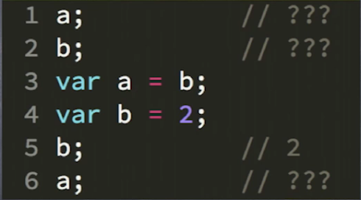
Hoisting

Slide 5
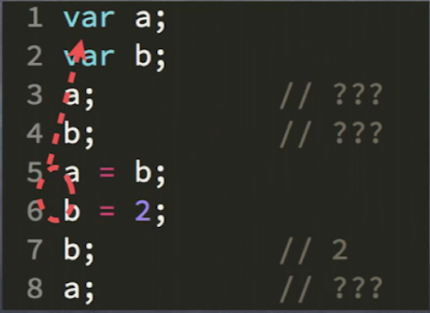

Slide 6
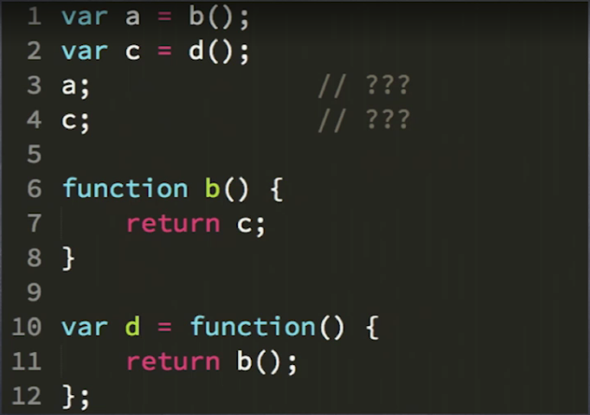
Hoisting

Slide 7
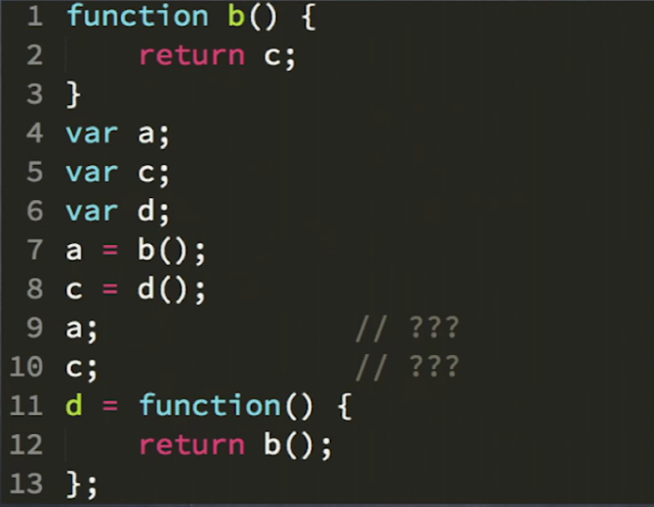
Hoisting

Slide 8
SCOPE
SCOPE
Notes:
https://developer.mozilla.org/en/docs/Web/JavaScript/Reference/Global_Objects/Object/create

Slide 9
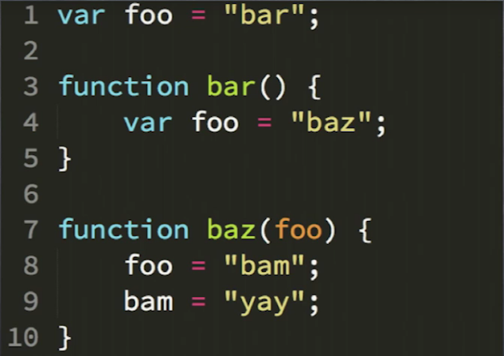
Scope (Hoisting)

Slide 10
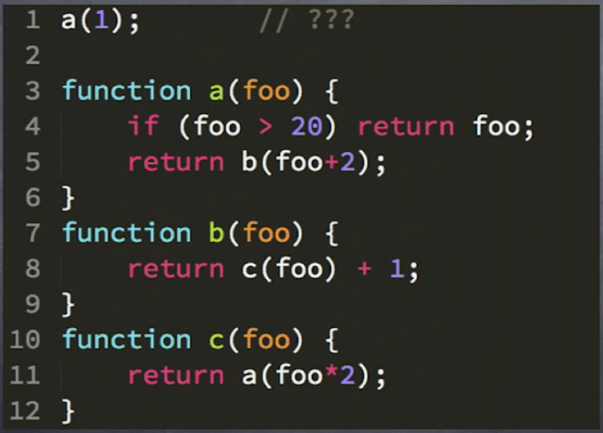
Question
Answer : 39

Slide 11
Compiling Function Scope

Slide 12
Executing Function Scope
Notes:
Undefined vs undeclared

Slide 13
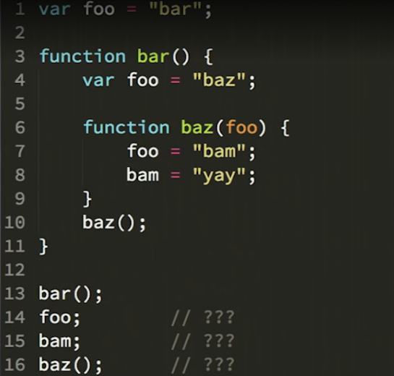
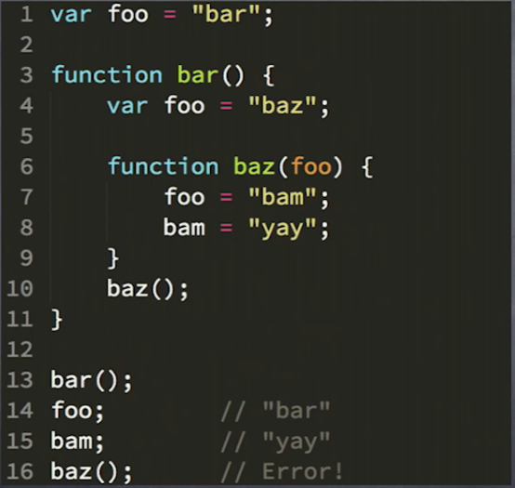
Scope and execution example

Slide 14
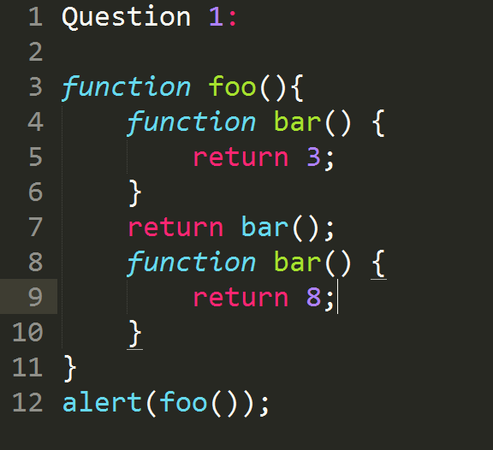
Function declaration vs Function Expression
Answer: 8

Slide 15
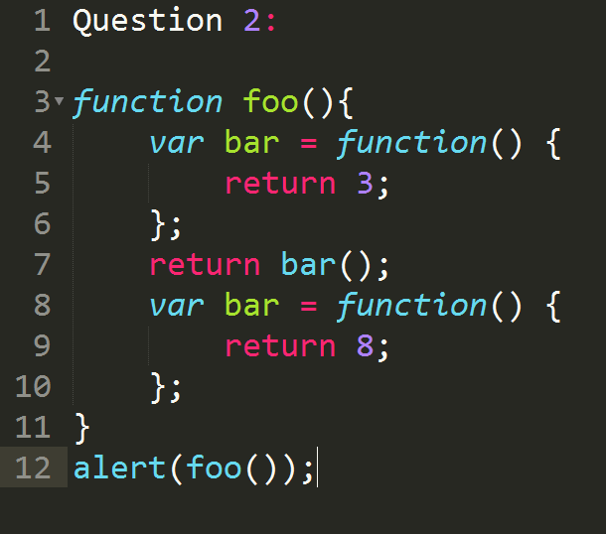
Function declaration vs Function Expression
Answer: 3

Slide 16
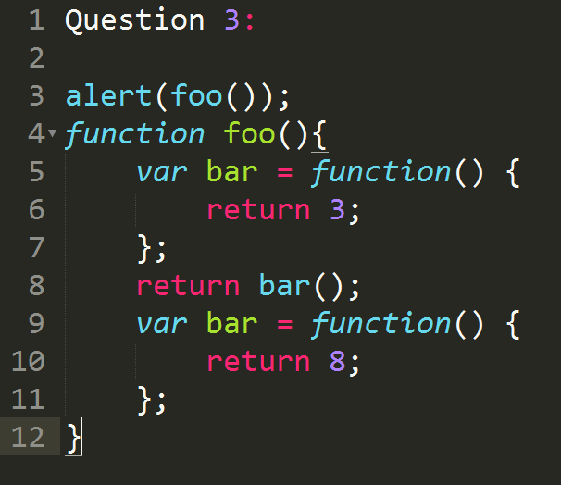
Function declaration vs Function Expression
Answer: 3

Slide 17
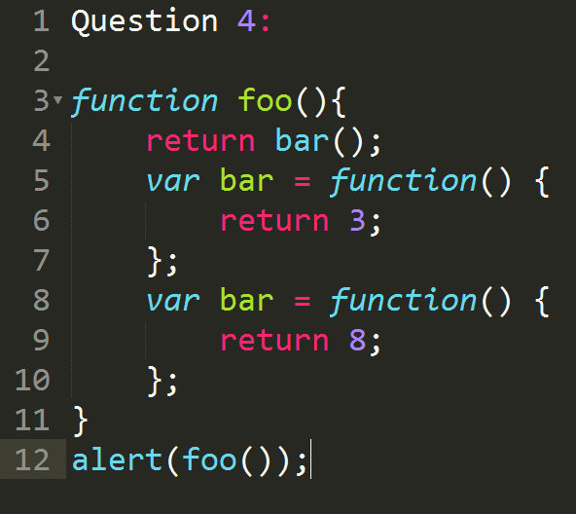
Function declaration vs Function Expression
Answer: Type Error: bar is not a function

Slide 18
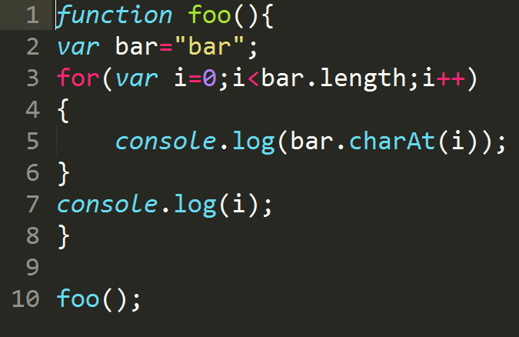
Question
Output:
b
a
r
3

Slide 19
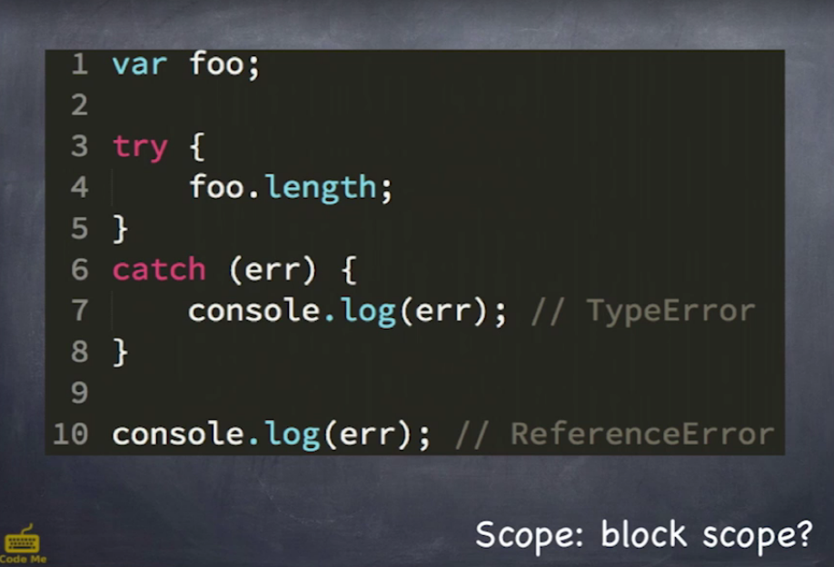
Block Scope

Slide 20
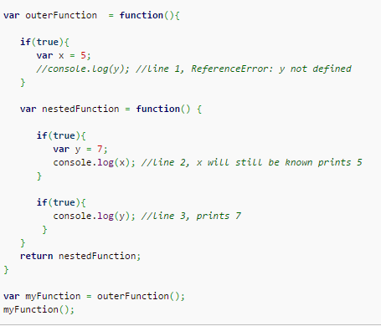

Lexical scope
In lexical scoping free variables
must belong to a parent scope.
Lexical Scope

Slide 21
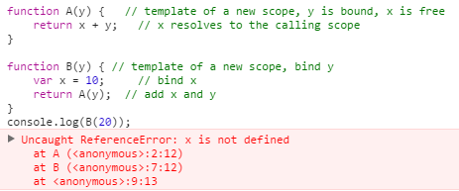
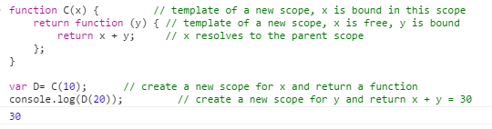
Question : Lexical scope

Slide 22
CLOSURE
Notes:
https://developer.mozilla.org/en/docs/Web/JavaScript/Reference/Global_Objects/Object/create

Slide 23
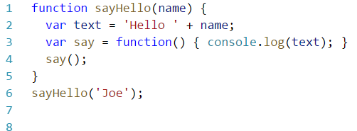
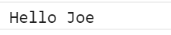
Closures
A closure is an inner function that has access to the outer (enclosing) function’s variables—scope chain.
In other words, these functions 'remember' the environment in which they were created.

Slide 24
Closures
Closures are a special kind of structure
Closure is when a function “remembers” its lexical scope even when the function is executed outside that lexical scope.
They combine a function and the context of this function
Closures are functions with preserved data

Slide 25
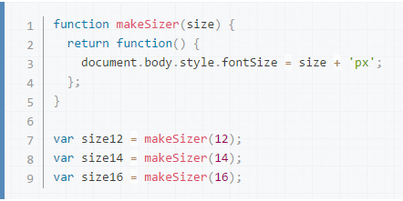
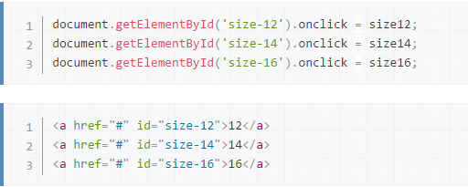
Closures (Practical Use)
You can use a closure anywhere that you might normally use an object with only a single method.

Slide 26
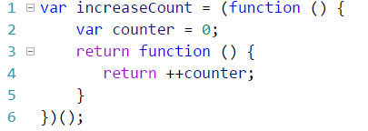
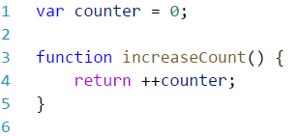
Closures
Global variables can be used (and changed) by all scripts in the page (and in the window).
The self-invoking function only runs once. It sets the counter to zero (0), and returns a function expression.

Slide 27
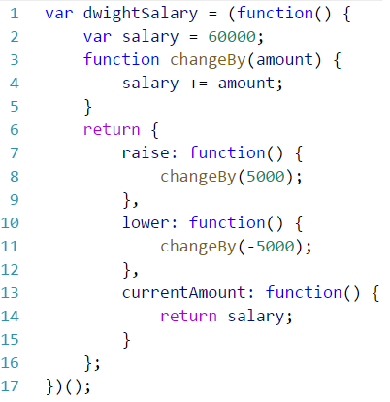
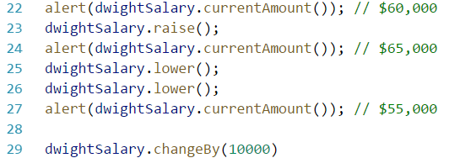
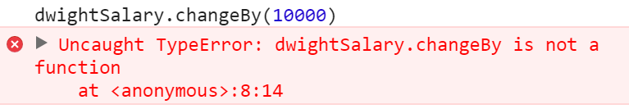
Closures (Private Functions)
JavaScript doesn’t have built in function to declare private variables, using closures we can emulate this functionality:

Slide 28
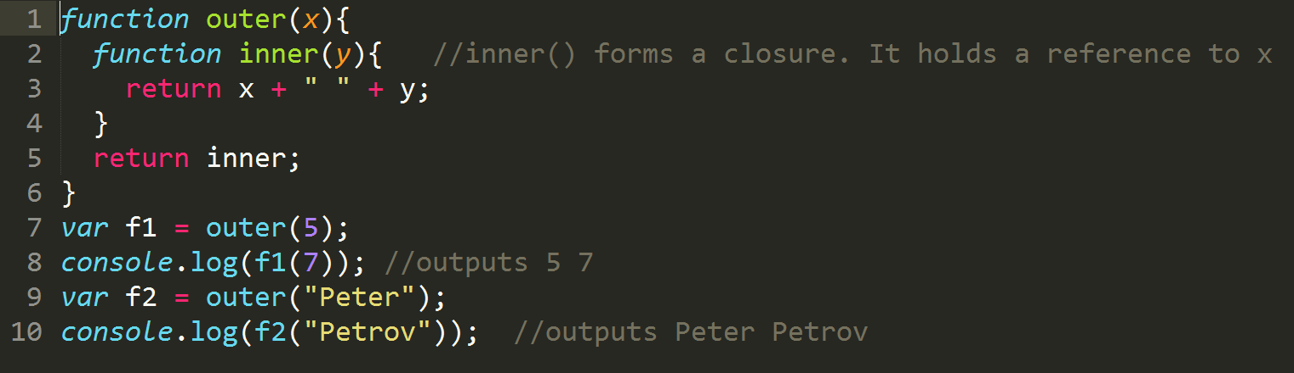
Examples:

Slide 29
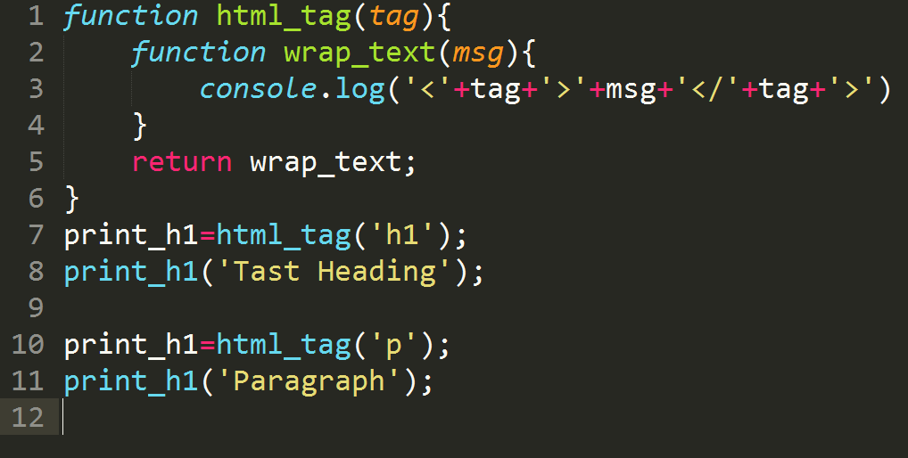
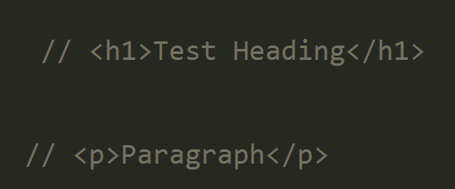
Examples:

Slide 30
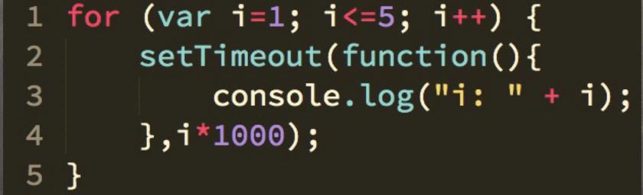
Examples: Closure loops
What will be the output here?
i: 6 - 5times repeat

Slide 31
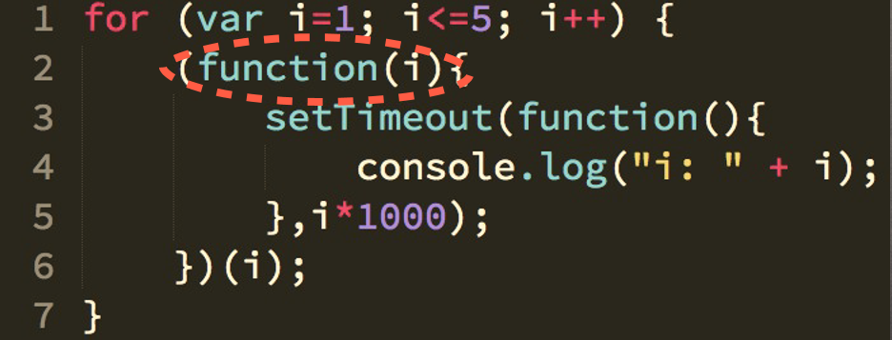
Cont..
To get the expected result we need to change the code as below:

Slide 32
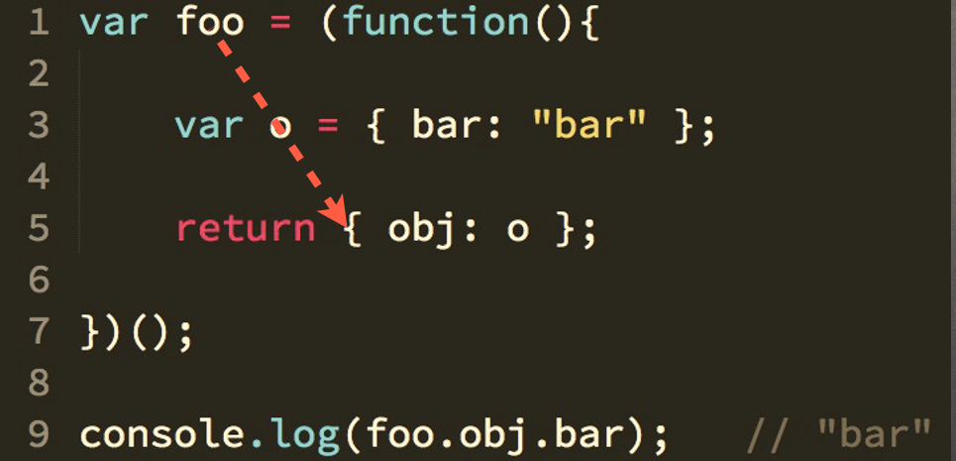
Is the following code a closure??

Slide 33
Cont..
It is not the closure because it is object reference not the function remembering the lexical scope.

Slide 34
THANK YOU!!!

